Slide 1
Small Landlord Analysis
Haoran Yang Yuesi Liu
Hanlin Zou Shun Yao

Slide 2
Background
Our goal
To help people with limited incomes find affordable housing.
HOW?
use some of the techniques of data science to help the project find more suitable homes
Our GitHub link:
https://github.com/BU-Spark/ds-councilor-louijeune-small-landlord/tree/dev/fall22-team-2

Slide 3
Datasets NAV
Base: Extension:
Boston Accessor Added Income Restricted.csv
boston-neighbourhood-data.csv
BostonAssessorsDataCleaned.csv
income-restricted-inventory-2021.csv
RentSmart.csv
Boston Accessor Added Income Restricted.csv
Building and Properties Violations.csv

Slide 4
1
Base Questions

Slide 5
# of units of landlords NOT currently enrolled in different affordable housing programs?
19304

Slide 6
Geographic distribution (by zip code)
Of NOT enrolled landlords

Slide 7
Distribution of races in Boston

Slide 8
current distribution of landlords in current affordable housing programs

Slide 9
Geographic distribution (by zip code)
Of enrolled landlords and whose housing

Slide 10
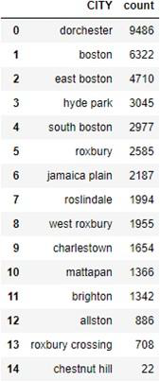
Geographic distribution of landlords by city

Slide 11
Visualization
Owner-occupied and small landlords: 75.91%
Affordable Owner occupied and small landlords: 36.27%

Slide 12
Extension
The top three companies with the most complaints are:
1. CABOOSE PROPERTIES LLC
2. ONE HUNDREND HALLEST ST LLC A MASS LLC
3. WILLIAMS NORMAN W

Slide 13
Most frequent complaints
Unsafe and dangerous
failure to obtain permits

Slide 14
Which city has the highest number of complaints

Slide 15

LIMITATIONS

Slide 16
breakdown of races for each city in the Boston area
Google map API
Redundant complaints

Slide 17
Thanks!

